Slide 1





Checker Wars
Group 16: Alex Choi, Andrew Macatangay, Sam Alammar, Luke Austin

Slide 2
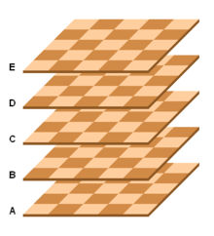
About
First game developed by Bohn Jell Entertainment (BJE)
Turn-based strategy game based off of checkers
Suitable for all audiences
Allows for more than 2 players
Intended to allow for endless flexibility in play style
More types of pieces than checkers
There are different spaces unlike checkers
Players get multiple actions per turn
The battlefield can have multiple layers
Different ways to win
Notes:
Checker Wars is a new, virtual take on the game of Checkers. It is being developed to entertain game players and provide a new game for online competitive play. The game is a multidimensional version of Checkers with extra pieces and challenging elements that provide a more challenging experience with greater replayability.

Slide 3

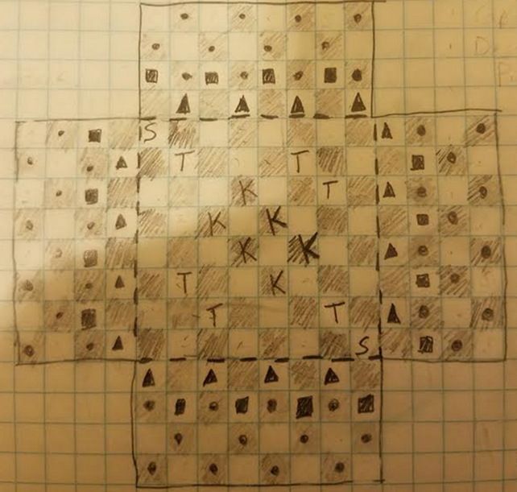
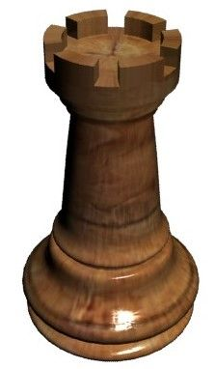
Objectives
Capture 3 towers
Capture all opponents’ pieces
Have fun!

Slide 4
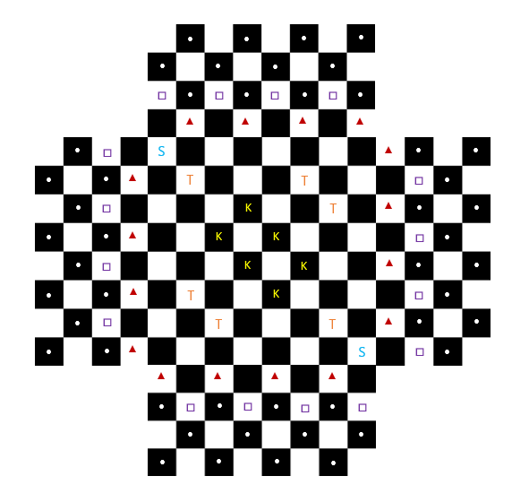
Scope of the product
Game Mode Select Scenario
Move Scenario
Attack Scenario
Victory Scenario
Notes:
Game Mode Select Scenario: On the menu select screen, the player may select to play single player mode against an AI opponent or multiplayer mode against a human opponent via the internet.
Move Scenario: Each player’s turn is determined by the roll of two die. The player with the highest roll goes first. This player gets to decide whether the order of turns goes clockwise or counterclockwise from them. Each player receives 5 actions per turn. Each round ends when every player has exhausted their turns. Though, similar to checkers, each attack takes up one turn, and if an attack is chained, each chained attack will not take up another turn.
Attack Scenario: The player moves to attack an opponent’s piece. Guardsman can attack all other pieces on white spaces. Nobles cannot attack other pieces. King’s can attack any other piece. All pieces attack in a manner similar to the game of checkers, in that they “jump” over the piece to “take” them, and land on the other side of the opponent's piece. A piece can only successfully attack another piece if it’s movement is unobstructed (can successfully land on the other side of the enemy piece.
Victory Scenario: A win is determined when either three towers are captured by one army or if the other players have no more pieces. When one player is completely defeated, they are out for the rest of the game and the game will continue with the other players. If for some reason, no moves exist for all players, the game ends in a draw.

Slide 5
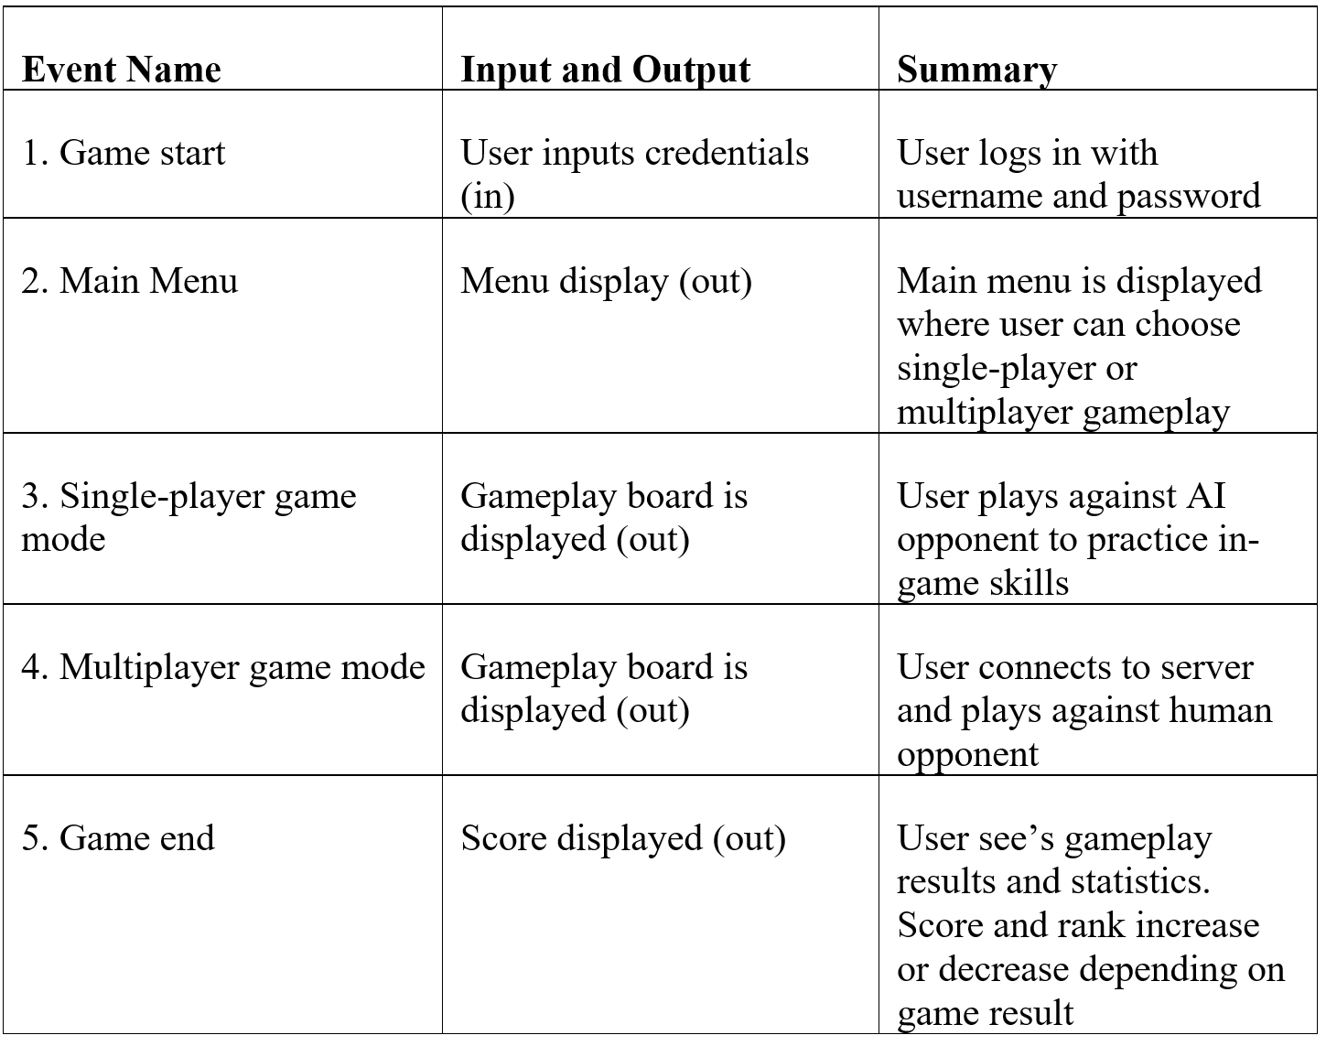
Scope of the work
Context of the work
Work Partitioning
Competing Products
Notes:
Bohn Jell Entertainment is a business solely focused on consumer entertainment. As such, Bohn Jell Entertainment is devoted to maximising consumer amusement through our creations. Checker Wars is the first game developed by BOHN JELL ENTERTAINMENT. This game will be able to be played online and has a diverse target audience. Not only is this game made to be easily approachable, but it will also be endlessly customizable by players. The game will be the first product and therefore only source of revenue for the company. Development is currently underway.
CONTEXT OF THE WORK
WORK PARTITIONING (refer to table on page)
3d: COMPETING PRODUCTS
Competitive single-player (with AI opponents) and multiplayer (both offline and online) games are all competitors for Checker Wars. Online Chess, Go, and similar strategy games are all competitors with Checker Wars. Some of these are standalone games, some of them are web apps, some are sold through services such as Steam or the Epic game store.

Slide 6

Stakeholders
The Client - Bohn Jell Entertainment - Outside graphics developers The Customer - Players of the game - All ages - Concentrated on 10-30 year old audience
Notes:
CLIENT This product is being commissioned by BOHN JELL ENTERTAINMENT. BOHN JELL ENTERTAINMENT has designed the specifications for the game, and is developing the logic code for the game in house, but is outsourcing graphic development.
THE CUSTOMER Checker Wars is aimed at teens and young adult players, however the game appeals to players of all ages due to its similarities with the game of checkers. The main focus will be on players who use streaming services such as twitch.tv. Both serious, competitive gamers and casual gamers will enjoy playing Checker Wars. Games usually take 5 to 10 minutes to start and finish, allowing students or workers who want a quick mental break from their study or work to fit in a quick game. Technological experience is only required at a novice level. The game is very easy to install and begin playing, and the gameplay is very intuitive and easy to pick up.

Slide 7

Constraints
Implementation Environment - Web Application/Windows/Mac/iOS/Android
Development constraints - Platform - Development environment/style - Competitive statistic gathering/calculations
Budget constraints - In-app purchases (cosmetic only)
Notes:
IMPLEMENTATION ENVIRONMENT: The game is to be played on Windows, Mac, iOS, and Android devices. The easiest way to accommodate this is to have the app developed as a web application first, wherein a user is required to log in through a website to play the game. This will be the first step in development, and local clients for each platform will be developed at a later date once the web application is completed.
DEVELOPMENT CONSTRAINTS: The game will be developed in an object-oriented language such as Java, C++, or Python. Checker Wars will require users to create an account in order to track their stats and update their rank on both the local and global leaderboards for competitive play.
BUDGET CONSTRAINTS: In-app purchases will only take the form of cosmetic additions to the gameplay, as we want to create a fair competitive environment for all players of the game regardless of funds available to player. Thus, it is important that we find investors and sponsors who share this vision with us. The scope of the game is not massive, so we hope that we will not need plentiful funds to complete development of the game.

Slide 8
Facts and Assumptions
Facts - Game developed initially as web application - Ports to consoles and platforms (Windows/Mac/iOS/Android) later
Assumptions - Player’s have minimum computing requirements to play game
Notes:
FACTS The game will take up a small amount of space when developed for individual platforms, but will initially all be hosted on BOHN JELL ENTERTAINMENT’s servers, and loaded (from BOHN JELL ENTERTAINMENT’s servers or local user cache) whenever a user logs on through the website. The game will be under 50MB in size.
ASSUMPTIONS It is assumed that the end user is using a sufficiently powerful computing device to play the game (2GB+ of RAM, modern ARM, Intel, or AMD processor).

Slide 9
FIN

